Slide 1
EURADOS Views
Future research needs: Radiation protection & Social science
Bratislava, Slovakia
On behalf of EURADOS
Veronika Olšovcová
ELI Beamlines
Institute of Physics, Academy of Sciences of the Czech Republic

Slide 2
EURADOS views on future research…
Introduction of EURADOS e.V.
Contribution of EURADOS to the goals of ENHANCE
Envisioned future research (SRA)

Slide 3
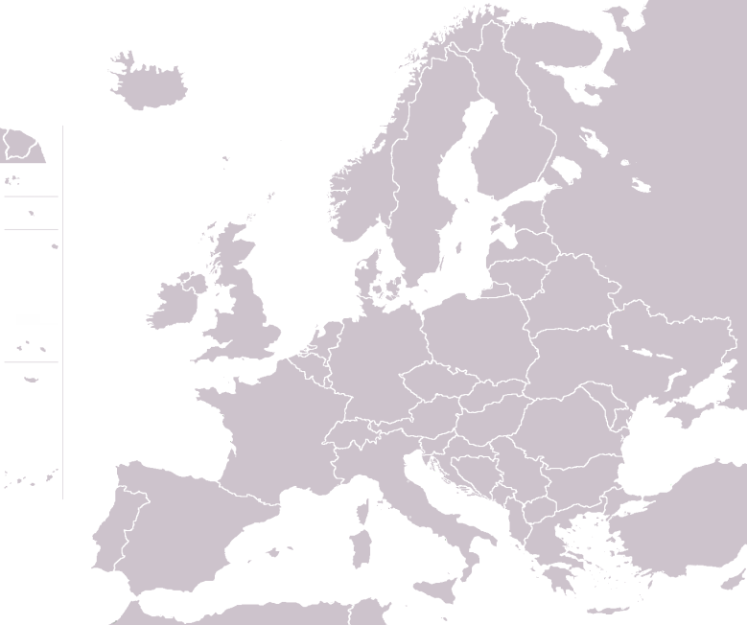
EURADOS (as of 2019)
Mission since 1982
Promote research and development in dosimetry
Contribute to harmonisation in dosimetric practice
•
Voting Member Status (May 2019)
73 Voting Members from 31 countries
$$·$$
EURADOS Board of Officers
Chair: W. Rühm (Helmholtz Munich, Germany)
Vice-Chair: F. Vanhavere (SCK-CEN, Belgium)
Secretary: JF. Bottollier (IRSN, France)
Treasurer: O. Hupe (PTB, Germany)
© EURADOS
© EURADOS
EURADOS Office
operated by HMGU (W. Rühm, K. Hürkamp, (H. Schuhmacher))
EURADOS Council
J.F. Bottollier, I. Clairand, E. Fantuzzi, P. Fattibene, R. Harrison, O. Hupe, M.A. Lopez, P. Olko, V. Olsovcova, W. Rühm, H. Schuhmacher, F. Vanhavere
© EURADOS
© EURADOS

Slide 4
Science in Dosimetry - EURADOS Working Groups
Eight EURADOS Working Groups
Harmonization of Individual Monitoring (P. Gilvin, UK)
Environmental Dosimetry (A. Vargas, Spain)
Computational Dosimetry (H. Rabus, Germany)
Internal Dosimetry (B. Breustedt, Germany)
Dosimetry in Radiotherapy (L. Stolarczyk, Poland)
Retrospective Dosimetry (C. Woda, Germany)
High-Energy Radiation Fields (M. Caresana, Italy)
Dosimetry in Medical Imaging (Z. Knezevic, Croatia)
•
$$·$$
© EURADOS
Associate Members
Almost 600 scientists contributing to the overall EURADOS mission
ENGAGE, Bratislava

Slide 5
Contribution of EURADOS to the goals of ENHANCE
ENhancinG stAkeholder participation in the GovernancE of radiological risks for improved radiation protection and informed decision-making
In the areas of interest of ENGANGE, ie.
Medical field
Emergency and Post-accident situations
Radon in dwellings
EURADOS community more focused on dosimetry aspects of Radioprotection
Notes:
improve the governance of radiological risks by strengthening and enhancing stakeholder engagement processes in relation to radiation protection policy and practice

Slide 6
Tools used by EURADOS to involve stakeholders
Offering and Enabling to take active role
Scientific workshops, Working groups
Common work and research
Winter schools, Training courses
Dissimination of information, education
Learning network
Intercomparisons
Harmonizing in dosimetry, Keeping high standards, Enhancing methodologies
Feedback: participant sessions
Webpage, publications
Exchange of information

Slide 7
EURADOS Working Groups
Eight EURADOS Working Groups
Harmonization of Individual Monitoring (P. Gilvin, UK)
Environmental Dosimetry (A. Vargas, Spain)
Computational Dosimetry (H. Rabus, Germany)
Internal Dosimetry (B. Breustedt, Germany)
Dosimetry in Radiotherapy (L. Stolarczyk, Poland)
Retrospective Dosimetry (C. Woda, Germany)
High-Energy Radiation Fields (M. Caresana, Italy)
Dosimetry in Medical Imaging (Z. Knezevic, Croatia)
•
$$·$$
© EURADOS
ENGAGE, Bratislava

Slide 8
Scientific Workshops
During Annual meetings
Topics – e.g.
Dosimetry for second cancer risk estimation in radiotherapy
Dosimetric Issues in the Medical Use of Ionizing Radiation
Training courses
3-5 days
Participation limited <40 participants
Various topics - answer to needs of the dosimetric community
Carried out by a specific WG
Topics incl. medical, post-accidental

Slide 9
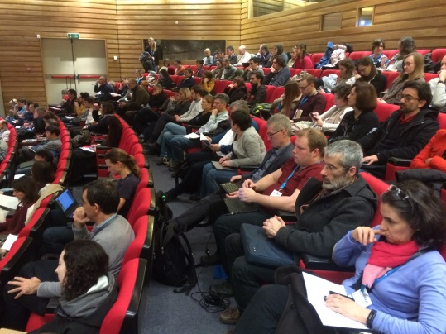
EURADOS Winter Schools
“Refresh courses” of 1-1,5 day
Held during Annual meetings since 2007
Topics have included:
Emergency situations
Post accidental situations
Medical field
Radon
Presentations available at www.eurados.org

Slide 10
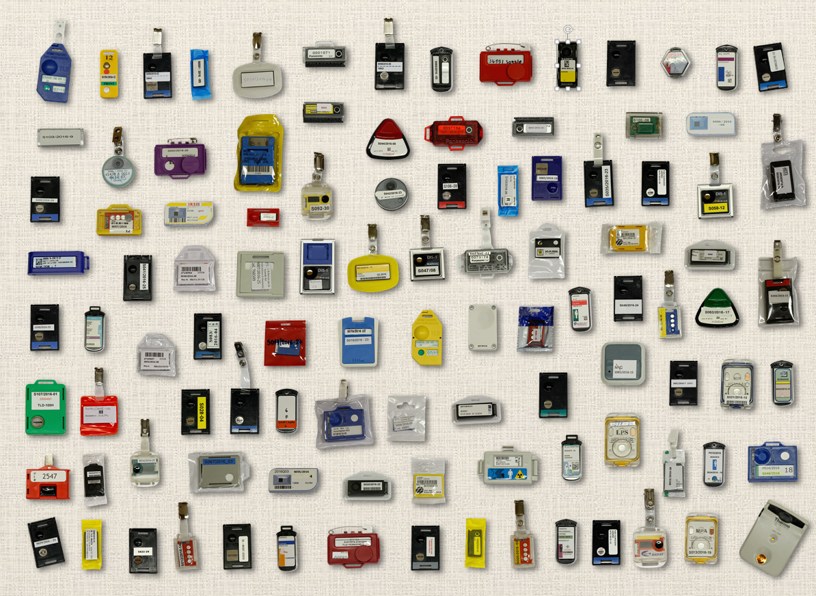
Intercomparisons
Organized regularly since 2008
Whole body dosemeters in photon fields
Extremity dosemeters in photon and beta fields
Neutron dosemeters
Next planned
Extremity and eye-lens in photon and beta fields
up to 100 participants with up to 120 systems per IC
Each IC exercise concluded by
Participants’ meeting:
To discuss the results of the IC exercise (anonymized),
To promote exchange of information among participants,
To summarize the topics and lessons to be learned from each edition
Dedicated report

Slide 11
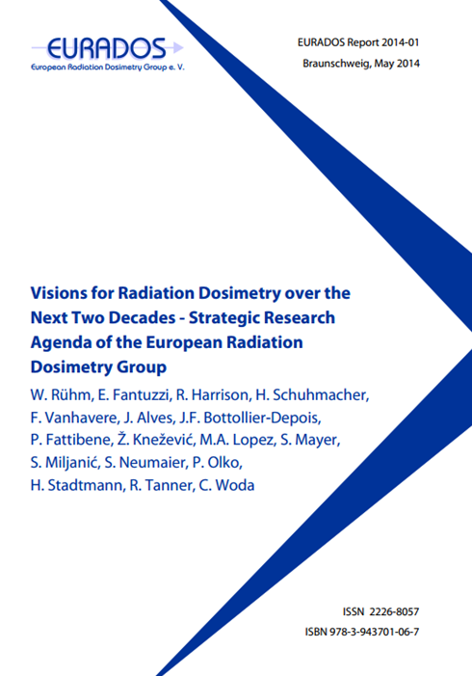
EURADOS SRA
Finished and published in 2014
Revision of SRA ongoing
Task group initiated by EURADOS Council
Coordination: Filip Vanhavere
With input from all Working Groups
2017-2018 SRA update based on:
Projects done, new important publications, evolutions, state of the art
Inputs from stakeholders: what is missing in SRA
Slightly revised (simplified) structure: some new and merged topics
Preparation of roadmaps
Information is collected, new version of SRA should be prepared in 2019, published 2020

Slide 12
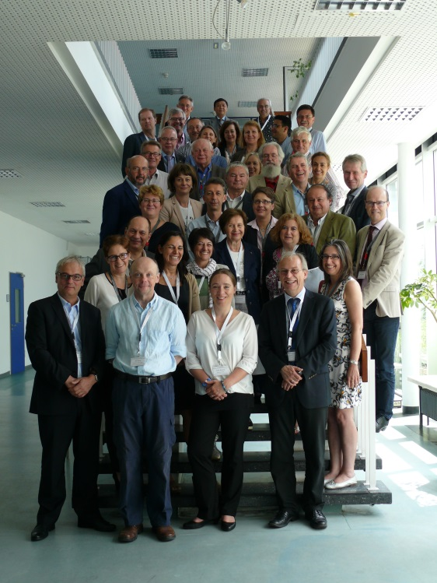
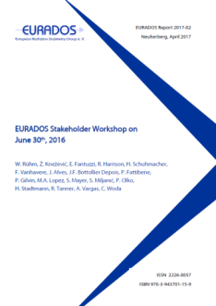
Planning of Research - Strategic Research Agenda (SRA)
EURADOS Stakeholder Workshop – June 30, 2016, Neuherberg, Germany
Meeting of 24 international organisations
Commenting on EURADOS SRA
Identifying missing topics
Expressing interest (or not) in future cooperations
EURADOS Report 2017-02: W. Rühm, Ž. Knežević, et al. "EURADOS Stakeholder Workshop on June 30th, 2016
Participating international organisations
ALLIANCE, EANM, EFOMP, ENISS, ESR, ESTRO, EURAMET, HERCA, IAEA, IARC, ICRP, ICRU, ILO, IRPA, ISO, ISSDO, MELODI, NEA, NERIS, NUGENIA, PTCOG, RENEB, SSH.
12
Prepared by W. Rühm, HMGU

Slide 13
EURADOS SRA
Social science research
Not explicitly included in SRA
Input by SSH community (C. Pölzl-Viol, BfS, Germany) during Workshop with stakeholders held in 2016
Identified topics of interest
Social and psychological aspects among the investigated cohorts
Acceptability of detection limits and the communication of risks and uncertainties
Social and psychological aspects among the citizens living in contaminated area
Improvement of communication between doctors and patients
Meeting of EURADOS and SSH to discuss how SSH could be linked to the EURADOS research would be beneficial

Slide 14
EURADOS SRA – common topics with ENGAGE
Medical field
Vision 4: Towards integrated personalized dosimetry in medical applications
To improve out-of-field dosimetry for photon and particle therapy
To develop microdosimetric models for imaging and radiotherapy
To improve dosimetry in modern external beam radiotherapy
To optimize dose and risk estimations in interventional radiology
To establish reliable patient dosimetry in CT examinations
Radon:
Vision 5: Towards improved radiation protection of workers and the public
To improve understanding of biokinetics and dosimetry of internal emitters

Slide 15
EURADOS SRA – common topics with ENGAGE
Emergency and post accident
Vision 2: Towards improved radiation risk estimates deduced from epidemiological cohorts
To improve exposure pathways not yet considered or validated
To improve retrospective dosimetry for exposure pathways already considered
Vision 3: Towards an efficient dose assessment for radiological emergencies
To identify and characterize new markers of exposure
To develop strategies and methods to increase measurement capacity
To quantify doses after accidental internal contamination

Slide 16
EURADOS – Views in a Nutshell
Fostering research and development in dosimetry important
To provide and ensure physics background for better understanding of behaviour of radiation and affected human body
Exchange and dissemination of information important
Sustainable Education and Training actions important
To enable continuous education of professionals, share the knowledge with new-comers to the field, keeping the knowledge up-to-date
Sustainable harmonisation in dosimetry important
To enable continuous improvement, keeping high standards, initiating discussions, providing feedback, dissemination of best practice
Systematic planning of international research important
Efficiency, reflecting the needs of society and scientific community, targeted research
International cooperation is indispensable!
Notes:
Fostering research and developement in dosimetry important
To provide and ensure physics background for better understanding of behaviour of radiation and affected human body
Means: Working Groups
Exchange and dissemination of information important
Sustainable Education and Training actions important
To enable continuous education of proffesionals, share the knowledge with new-comers to the field, keeping the knowlege up-to-date
Means: Annual Meetings, Publications, Winterschools, Trainings
Sustainable harmonisation in dosimetry important
To enable continuous improvement, initiating discussions, providing feedback, dissimination of best practice
Keeping and improving Means: Intercomparisons
Systematic planning of international research important
Efficiency, reflecting the needs of society and scientific community, targeted research
Means: SRA, roadmaps)
International cooperation is indispensable!

Slide 17
THANKS FOR YOUR ATTENTION ☺

