Slide 1
ENhancinG stAkeholder participation in the GovernancE of radiological risks for improved radiation protection and informed decision-making
ETHICAL ISSUES
Liudmila Liutsko & Gaston Meskens
ENGAGE final project meeting, Bratislava, 11-13 September 2019

Slide 2
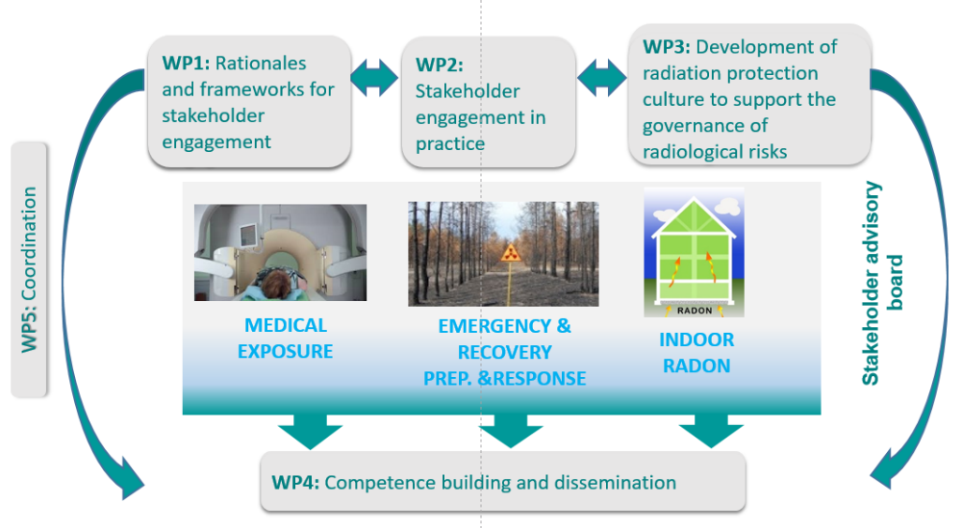
Focus on stakeholder engagement: Ethical issues
DIMENSIONS of Discussions:
From Macro:
Social (cultural & historico-social, political) level
…
…
…
To Micro:
- Individual level
ETHICAL ISSUES:
Transversal to all three ENGAGE cases: Medical, EP&R, Radon
Specific to each case

Slide 3
Ethics? Three approaches
Ethics: As moral agents, being concerned with questions of
‘what ought to be’ (→ right and wrong conduct)
(→ rights and responsibilities)
in absence of ‘evidence’ that would facillitate
straightforward judgement,
consensus and
consequent action.
↘ ‘what ought to be’ → a good society, a fair society
→ to act responsibly
→ being good, leading a good life
↘ missing ‘evidence’ → a convincing scientific proof
→ a democratically constituted law
→ a universal principle to guide moral evaluation

Slide 4
Ethics? Three approaches
Question ‘what is a stakeholder’ ?
ENGAGE: pragmatic consensus
? Open question: what about animals and plants? (‘the rights of nature’)
Ecocentrism versus anthropocentrism?
‘solution’: stakeholders not only have rights but also responsibilities (animals and plants have no responsibilities)
idea of ‘responsible anthropocentrism’

Slide 5
Ethics? Three approaches
■ International Commission on Radiological Protection initiative on
the Ethics of Radiological Protection.
ICRP Publication 138 on the Ethical Foundations of the System of Radiological Protection
http://www.icrp.org/publication.asp?id=ICRP%20Publication%20138
→ core ethical values underpinning the system of radiological protection:
- beneficence and non-maleficence
- prudence
- justice
- dignity
→ key procedural values for the practical implementation of the system
- accountability,
- transparency
- inclusiveness

Slide 6
Ethics? Three approaches
■ The challenge of ethical thinking
dealing with
→ knowledge related (scientific) uncertainty
→ value pluralism & values in conflict (e.g. autonomy vs protection)
→ the problem of reference (e.g. sustainability)

Slide 7
questions

Slide 8
questions
■ How can the ethical values proposed by the ICRP …
→ motivate stakeholder engagement?
→ inspire ‘good’ stakeholder engagement? In theory? In practice?
→ core ethical values underpinning the system of radiological protection:
- beneficence and non-maleficence
- prudence
- justice
- dignity
→ key procedural values for the practical implementation of the system
- accountability,
- transparency
- inclusiveness

Slide 9
questions
■ What are ethical issues specific to each case (Medical, EP&R, Radon) (still) in need of attention?
→ How do they relate to stakeholder engagement?
→ How could they be tackled through stakeholder engagement?
Note: Some issues are relevant for all cases, but have specific meanings and challenges in different cases (an important one: justification)

Slide 10
questions
■ What are ethical issues relevant to (‘transversal to’) all three ENGAGE cases (Medical, EP&R, Radon) (still) in need of attention?
→ How do they relate to stakeholder engagement?
→ How could they be tackled through stakeholder engagement?
example How to motivate people (general public) to participate and to give them information, education on IR if they do not want or care?
for EP&R Balance: “preparation for a possible nuclear accident” vs. “do not alarm and create stress”?
for medical in case of urgencies – balance: “to save life first” (similar issue in the evacuation at emergency phases after a nuclear accidents) versus “providing information in the interest of getting informed consent”

Slide 11
questions
■ What are ethical issues relevant (‘transversal’) to all three ENGAGE cases (Medical, EP&R, Radon) (still) in need of attention?
→ How do they relate to stakeholder engagement?
→ How could they be tackled through stakeholder engagement?

Slide 12
questions
■ Informed consent is a concept and value essential for the medical context, but why not extend the term to the other contexts and promote it as a general value for stakeholder participation?

Slide 13
questions
■ The scientific community is an important stakeholder in general RP and in the specific cases of EP&R, medial and Radon. Are there specific ethical challenges for science as public information and policy advice? If yes, which challenges?

