Slide 1
ENGAGE final workshop 11-13 September 2019 Bratislava, Slovak Republic PRESENTATION OF MAIN FINDINGS AND DRAFT RECOMMENDATIONS, ILLUSTRATION WITH CASE STUDIES
T5: Informed decision-making (role of communication access to information, informed consent)
Marie Claire Cantone, UMIL

Slide 2
Recommendations, WHAT is needed WHY is needed HOW can be done
a synthesis of the main Recommendations for Stakeholder engagement, as emerging in ENGAGE Project for each exposure situation
the motivations, WHY, and the approaches, HOW, to proceed towards the Recommendation implementation

Slide 3
T5: Informed decision-making -List of Recommendations
EP&R
MEDICAL
RADON
Establish communication tools for continuous information about emergency plans, tailored towards specific stakeholders;
Elaborate the extent and content of prior information based on the BSS requirements, as well as stakeholders’ needs;
Establish conditions for continuous feedback in EP&R.
Enabling patients to exercise the right of informed consent in decision-making;
Implementing an effective risk communication strategy, as component of good practice in medical exposure.
Make use of Internet as an opportunity for two-way communication with, and engagement of stakeholders;
-Develop risk communication tools in collaboration with local stakeholders.

Slide 4
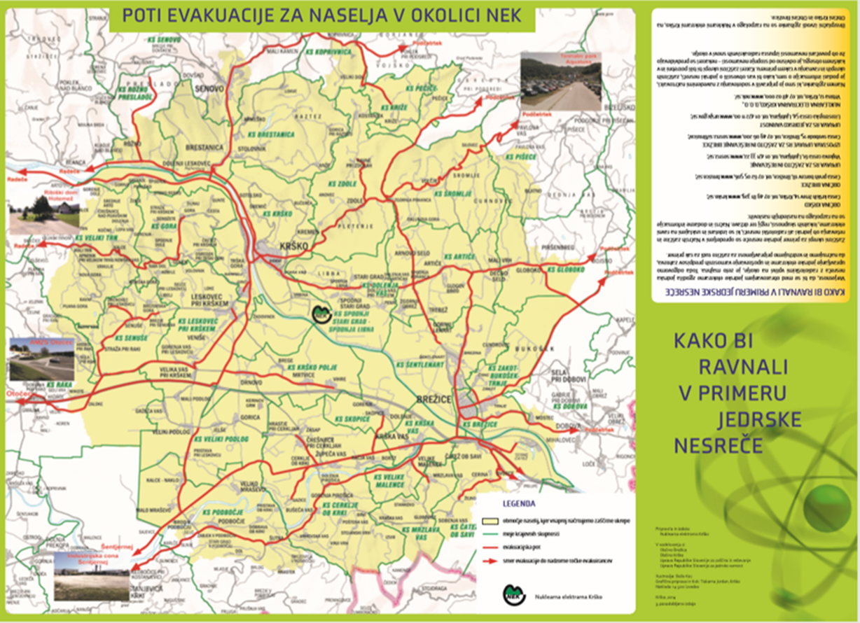
Informed decision-making: role of communication, access to information (EP&R)
Information about what to do in case of a nuclear accident is present at the level of national or local EP&R plans. However, this information is not necessarily known and understood by citizens.
Stakeholder engagement also requires a common language.
The stakeholders as perceived by the authorities are almost limited to official representatives. Only municipalities perceive the local population as their principal stakeholder.
As an accident could have wider impacts, not limited to the population living near a nuclear power plant, there is a need for two-way communication with population living in a wider area.
Recommendation EP&R 6: Establish communication tools for continuous information about emergency plans, tailored towards specific stakeholders

Slide 5
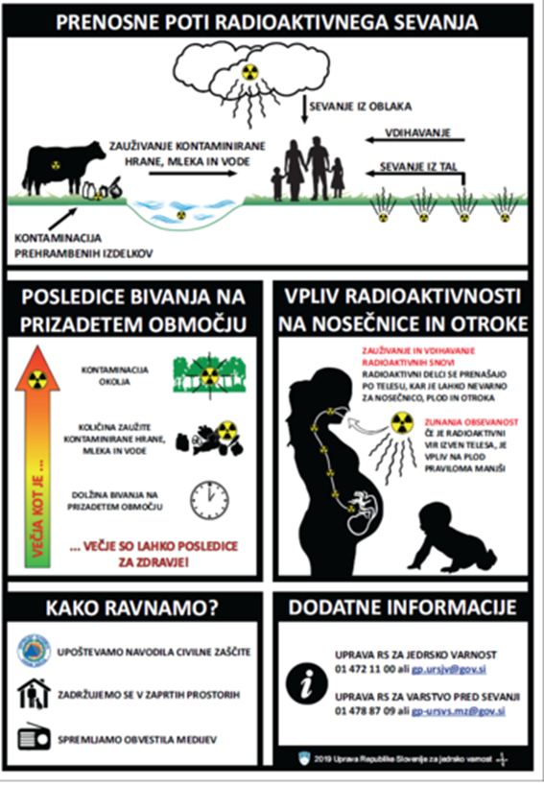
Informed decision-making: role of communication, access to information (EP&R)
Legal requirements give indications of what information to provide to members of public affected in the event of an emergency. There are, however, insufficient details concerning the extent of information, and not all content is covered. The methods, channels and content of information should be developed in advance as much as possible.
In Slovenia for example, two leaflets are prepared, distributed (partially) and available on internet for local population.
In France, CODIRPA is currently preparing leaflets for the population to be used after an accident, one for health professionals to help them answer questions that could be raised by the population.
Communication with the public during an emergency focus on procedures for issuing press releases and for providing factual information. Other information should also be available: public concerns regarding possible health effects, information to vulnerable groups, like elder population or pregnant women (Iodine prophylaxes, evacuation options,..).
Recommendation EP&R 7: Elaborate the extent and content of prior information based on the BSS requirements, as well as stakeholders’ needs

Slide 6
Informed decision-making: role of communication, access to information (EP&R)
Participants in the case studies pointed out several benefits of stakeholder engagement, such as feedback to improve the EP&R approaches and materials, providing local knowledge or new insights, supporting the search for better solutions.
Importance of broader stakeholder participation (including representatives of local communities, NGO’s, civil society organizations) in emergency exercises has been highlighted. Therefore, it is very important to establish ways for collection of feedback constantly.
Recommendation EP&R 8: Establish conditions for continuous feedback in EP&R

Slide 7
Informed decision making: role of communication, access to information, informed consent (Medical)
The need for guidance, on how involve, has been revealed; particularly in informed consent, can be practiced by patients and health professionals. Informed consent is an important ethical and practical part of engaging with patients or personal representatives, including information, compre-hension and voluntariness, as a process and not a simple act of signing a formal document.
Patient has the right to accept or object the procedure related to exposure; the respect for human dignity should be promoted with informed consent.
It is also a moral and societal duty not to leave patients, or more in general people, without giving them the opportunities of developing their own judgements on the basis of the shared information.
Recommendation Medical 5: Enabling patients to exercise the right of informed consent in decision-making

Slide 8
Informed decision making: role of communication, access to information, informed consent (Medical)
Risk communication is recognised as a fundamental support for the level of quality in the health care structures, and for improving trust in the relationship professional-patient. Thus, as part of participation at decision making processes, risk communication needs to be strengthened in the practice, considering also the contribution of support by social scientists.
The advantage of comprehensive publications regarding communication on risk and benefits, in I.R. in medicine, including information on compa-risons about the risks, potential alternative procedures and the role within the informed consent, could be of great significance in the practice.
Recommendation Medical 6: Implementing an effective risk communication strategy, as component of good practice in medical exposure

Slide 9
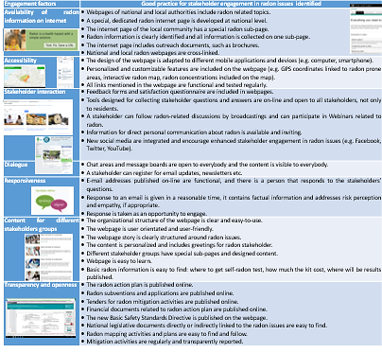
Informed decision making: role of communication, access to information, informed consent (Radon)
Personal engagement by using internet, in particular through radon websites, can enable collaborative, traceable, searchable, linkable, and open engagement.
It can empower stakeholders to contribute their own ideas, suggestions, and requests.
Websites with social media links promote transparency, participation, and collaboration.
An analysis of radon websites in eight European countries shows that internet is not used to its full potential.
➔ see case study with website analysis
Recommendation Radon 9: Make use of Internet as an opportunity for two-way communication with, and engagement of, stakeholders

Slide 10
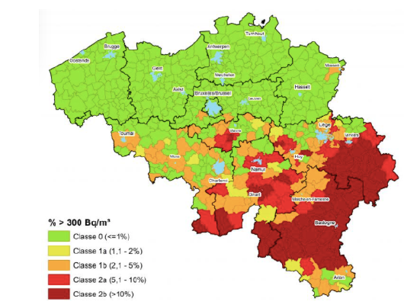
Informed decision making: role of communication, access to information, informed consent (Radon)
Definition of risk zones for radon follows BSS (Article 103 (3))
zones in which the concentration of radon in a large number of buildings should exceed (as an annual average) the relevant national reference level
Interactive maps are very useful tools for raising awareness by showing where the risk is above average.
However, such maps can be misleading for local actors:
this categorisation may demobilize population living in an area that is NOT referred to as a high risk zone on the map.
large coloured zones might convey the idea that radon risk is somehow uniform in a local zone, while the experience shows the contrary.
➔ see e.g. case study in Belgium
Additionally, disparities in radon risk awareness may be due the focus of awareness raising campaigns on areas with highest risk.
Recommendation Radon 10: Develop risk communication tools in collaboration with local stakeholders
Notes:
The probability of measuring a level of radon much above the recommendations in dwellings is not limited to risk areas as they are defined by the tool

