Slide 1
ENGAGE final workshop 11-13 September 2019 Bratislava, Slovak Republic PRESENTATION OF MAIN FINDINGS AND DRAFT RECOMMENDATIONS, ILLUSTRATION WITH CASE STUDIES
T2: Broadening the scope of ‘participation’ in radiation protection (beyond formal institutional approaches, new actors)
Nadja Zeleznik, EIMV

Slide 2
T2: Broadening the scope of ‘participation’ in radiation protection (beyond formal institutional approaches, new actors)
EP&R: 3 recommendations
Broadening the scope of ‘participation’ in EP&R (beyond formal institutional approaches, new actors)
Develop guidelines on how to engage stakeholders through formal and informal stakeholder engagement
Explore which stakeholders are” in” or “out” of stakeholder engagement and why not
Medicine: 1 recommendation
A proactive involvement of different stakeholders could start to be operative on the basis of their commitment
Radon: 2 recommendations
Integrate radon risk management into a global public environmental and health protection approach, with engagement of all levels of public authorities involved in these issues
Establish a network of (local) radon consultants and experts

Slide 3
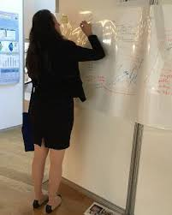
Broadening the scope of ‘participation’ in radiation protection (beyond formal institutional approaches, new actors) EP&R
Broadening the scope of ‘participation’ should be done: stakeholders and participation:
Prescription are focused to „emergency managers“ (or decision makers) and affected public, but case studies propose to broaden engagement to “every interested party […] that can be affected by the […] consequences of the emergency situation, that have to act to limit its consequences, or that participate in the control of the event”, like nurses, trusted people, parents or school personnel.
Opportunity to answer important questions concerning desirable actions in an emergency situation, e.g. ‘what will parents actually do in an emergency situation?’; ‘will they leave their children at school?’.
Prescription foreseen often mainly raising public awareness and ‘information’ (e.g. information sessions with Q&A – Belgium, leaflets – Slovenia), and, to a lesser extent, are ‘consultation’.
Scope of ‘participation’ needs to be broadened, also in the preparedness phase.
Recommendation EP&R 3: Broadening the scope of ‘participation’ in EP&R (beyond formal institutional approaches, new actors)

Slide 4
Broadening the scope of ‘participation’ in radiation protection (beyond formal institutional approaches, new actors) EP&R
Stakeholders should be involved via formal and informal engagement, however, a tension field appears to exist between formal and non-formal engagement, expressed between consensus and dissensus, dialogue and debate, communication and participation, and definitions of stakeholder and of engagement.
A key issue is the issue of power, more specifically ‘who’ is in power (e.g.. the government?) and can decide who should be involved and to what extent (different in various EP&R phases).
It could be noted that not all stakeholders want to be involved necessarily in a formal manner; however, they do wish their voices to be heard and their concerns addressed (Belgium case).
Recommendation EP&R 4: Develop guidelines on how to engage stakeholders through formal and informal stakeholder engagement

Slide 5
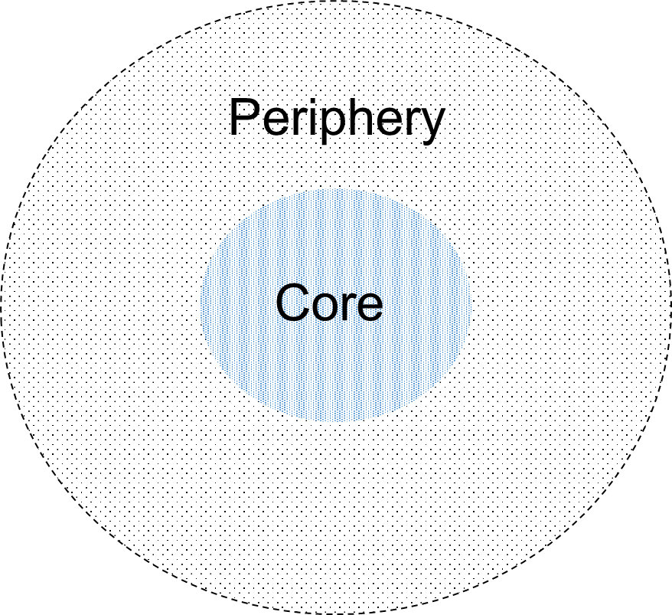
Broadening the scope of ‘participation’ in radiation protection (beyond formal institutional approaches, new actors) EP&R
In EP&R it is not always clear who is “in” or “out” of stakeholder engagement (e.g. future generations can and should be involved as a stakeholder or their role is mainly for keeping ‘memories alive’?, what to do with ‘non-participants’, non-human stakeholders (for example animal or, plants)).
The case study on participation outliers (cfr purposeful mapping) also shows the importance of stakeholders that do not want to participate: ‘how should EP&R deal with dis-engagement?
Further developments EP&R 1: Explore which stakeholders are” in” or “out” of stakeholder engagement and why not

Slide 6
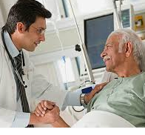
Broadening the scope of participation in radiation protection (beyond formal institutional approaches, new actors) Medicine
Broadening the participation in medicine in view of better communication and by considering a patient centred information process, can create advantages for patients.
Trust and confidence are considered as a good base in managing challenges in an adequate way also in medical field.
The involvement of stakeholders in justification and optimization process is needed and recognised to achieve a more effective and sustainable decision.
Broadening the scope of participation can to be helpful for patients and families to frame the meaning of radiation exposures, assure awareness about risk - benefit, to get information from guidelines dedicated to patients, and also to contribute with questions.
Recommendation Medical 2: A proactive involvement of different stakeholders could start to be operative on the basis of their commitment

Slide 7
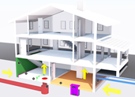
Broadening the scope of ‘participation’ in radiation protection (beyond formal institutional approaches, new actors) RADON
Radon is at the same time a public health problem, an environmental problem, an economic problem, and an urbanism problem.
Many fields of responsibility (private and public).
Radon management coordinated nationally by radiation protection/nuclear regulatory authorities
Radon mitigation also connected to other fields, such as health or energy performance.
An integrated approach of environment-health issues together with urban planning and energy saving policies would favour the involvement of citizens and the adoption of protective measures.
Recommendation Radon 4: Integrate radon risk management into a global public environmental and health protection approach, with engagement of all levels of public authorities involved in these issues

Slide 8
Broadening the scope of ‘participation’ in radiation protection (beyond formal institutional approaches, new actors) RADON
The lack of radon experts, particularly at local level, is a strong limitation for the involvement of citizens in remediation actions.
Few experts, who are not fully available, not at the local levels and generally inducing significant costs.
In some countries there is even a lack of radon experts at national level.
➔ see e.g. case study in Slovenia
Availability of radon consultants at all levels of governance may help with achieving an adequate level of measurements and individual mitigation.
➔ see e.g. case study in France
Recommendation Radon 5: Establish a network of (local) radon consultants and experts

Slide 9
Round table on recommentadions
a synthesis of the main Recommendations for Stakeholder engagement, as emerging in ENGAGE Project for each exposure situation
the motivations, WHY, and the approaches, HOW, to proceed towards the Recommendation implementation

